Slide 1
NON LINEAR REGRESSION MODELS

Slide 2
There are numerous regression models that are inherently nonlinear in nature.
Non Linear models are :
Neural networks
Multivariate adaptive regression splines (MARS)
Support vector machines (SVMs)
K-nearest neighbors (KNNs).
Tree-based models are also nonlinear.

Slide 3
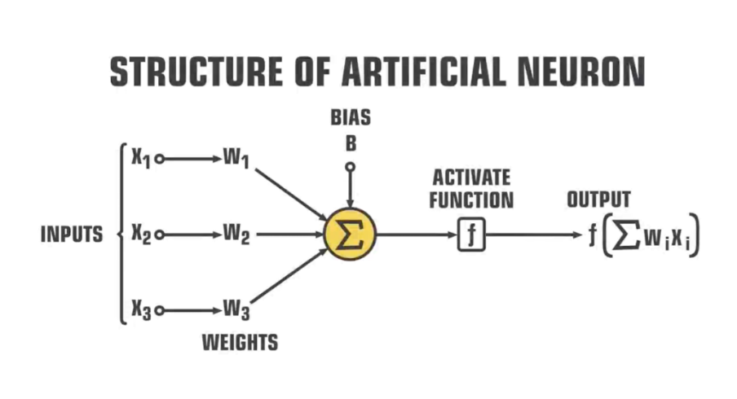
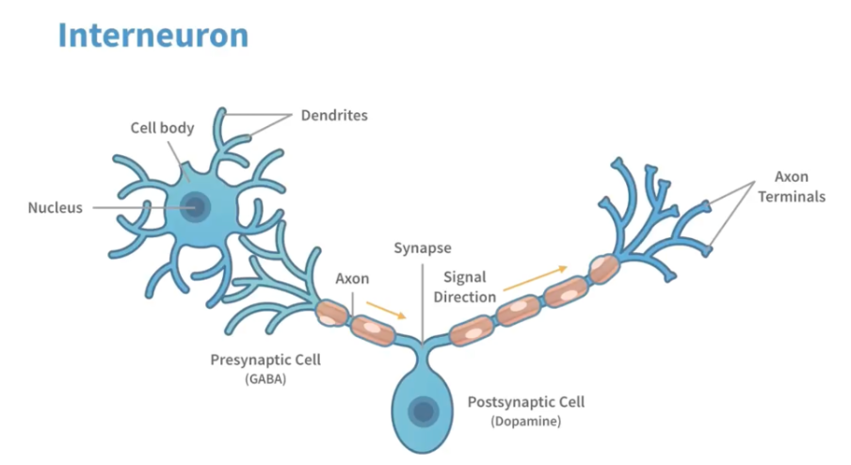
Neural networks
The outcome is modeled by an intermediary set of unobserved variables (called hidden variables or hidden units here).
These hidden units are linear combinations of the original predictors.

Slide 4
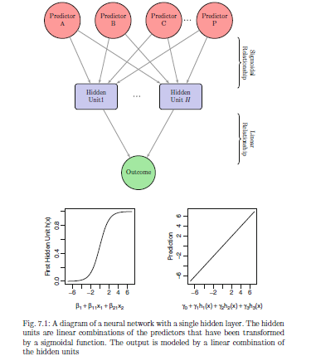

Slide 5
Treating this model as a nonlinear regression model, the parameters are usually optimized to minimize the sum of the squared residuals.
This can be a challenging numerical optimization problem.
The parameters are usually initialized to random values and then specialized algorithms for solving the equations are used.
The back-propagation algorithm is a highly efficient methodology that works with derivatives to find the optimal parameters.
However, it is common that a solution to this equation is not a global solution, meaning that we cannot guarantee that the resulting set of parameters are uniformly better than any other set.

Slide 6
Also, neural networks have a tendency to over-fit the relationship between the predictors and the response due to the large number of regression coefficients.
To combat this issue, several different approaches have been proposed.
First, the iterative algorithms for solving for the regression equations can be prematurely halted . This approach is referred to as early stopping and would stop the optimization procedure when some estimate of the error rate starts to increase

Slide 7
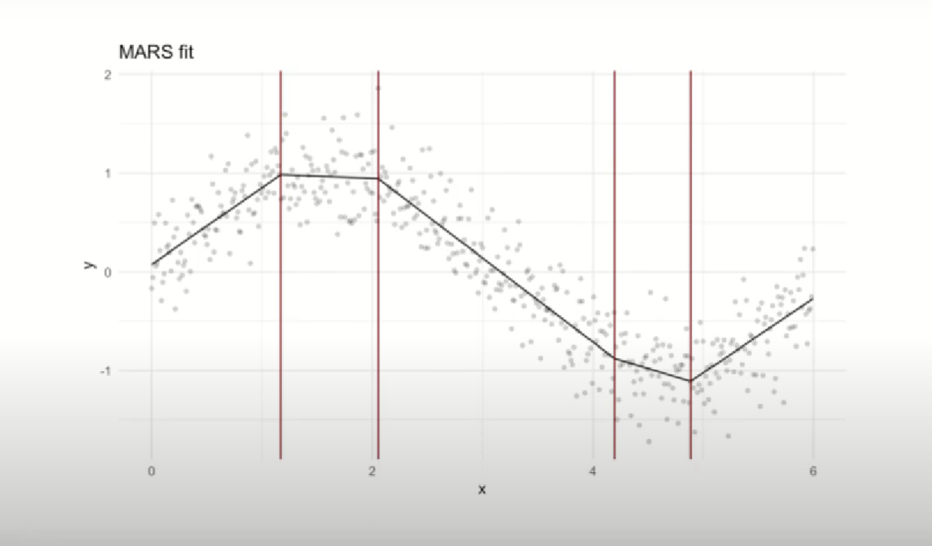
Multivariate adaptive regression splines (MARS)

Slide 8
